Slide 1
Immigrant location recommendation using machine learning
Rashmith Reddy Boppidi

Slide 2
Introduction
Business problem:
People who always wanted to move to toronto often fail to choose the place to move in toronto surrounded with their similar interests of living, this issue can be solved if they can find out the neighbourhood which are similar to their interest. This problem can be solved by clustering.
Objective:
To find similar neighborhood for an immigrant if he decides to move to toronto.
Target Audience:
Any immigrant who wants to move into toronto.
Stakeholders:
1)Any organisation who can act as a middle party to recommend their clients.
2)And individual Client by himself

Slide 3
Data acquisition and cleaningand cleaning
List of postal codes of Canada: M from Wikipedia. (https://en.wikipedia.org/wiki/List_of_postal_codes_of_Canada:_M)
Coordinates of the Toronto Neighbourhoods from csv file. (http://cocl.us/Geospatial_data)
Foursquare Location data. (http://foursquare.com/)
Cleaned data had 3 features.
Rows which were not available were removed.

Slide 4
K-means clustering for clustering the neighbourhoods
Based on the basis of common venues k-means clustering Machine Learning is used, which is unsupervised, in order to cluster the neighbourhoods together.
K = 5 was selected to go with.

Slide 5
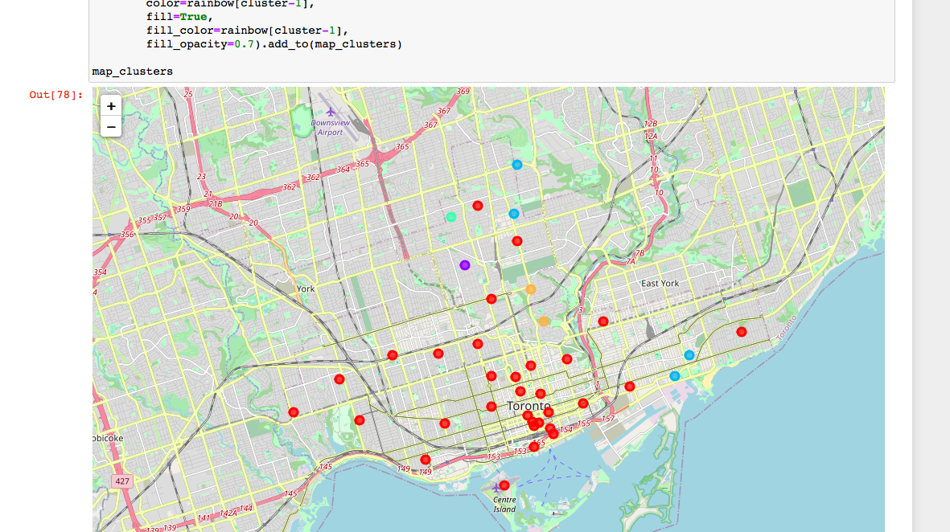
Visualization of different clusters

Slide 6
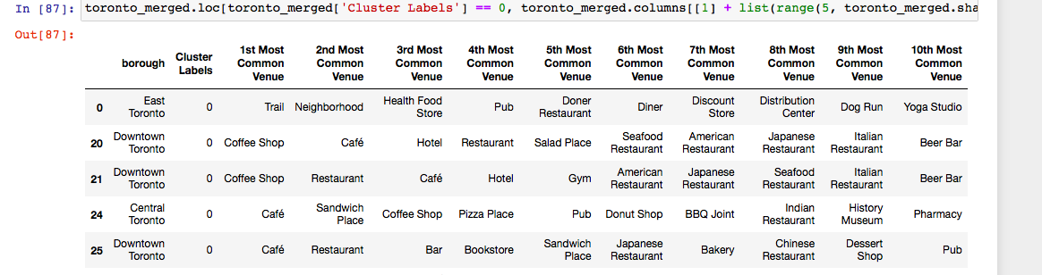
Cluster 1

Slide 7
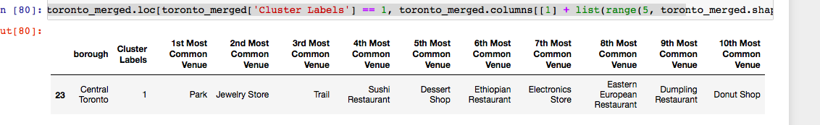
Cluster 2

Slide 8
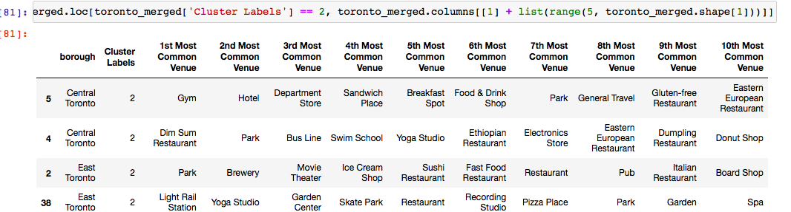
Cluster 3

Slide 9
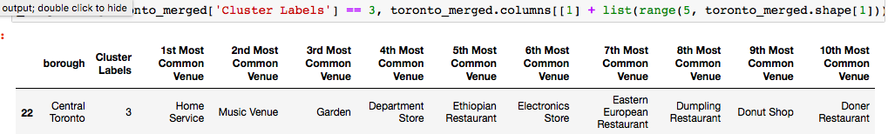
Cluster 4

Slide 10
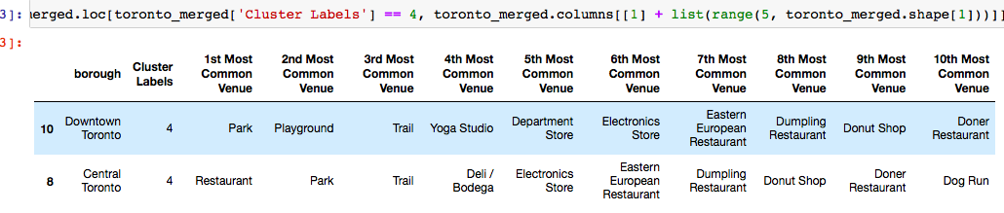
Cluster 5

Slide 11
Result and Observations
We have successfully divided our data into 5 clusters. Now the person can select the locations based on his similarity. most of the neighbourhood fall under cluster 0, they have mostly coffee shops and cluster 1 has park, cluster 2 has gym and restaurants with swimming pool has most common , cluster 3 home services, cluster 4 parks and other activity places

